Slide 1


UNIT 1: Time for school
Unit 1 – Roundup & Writing rules 1

Slide 2
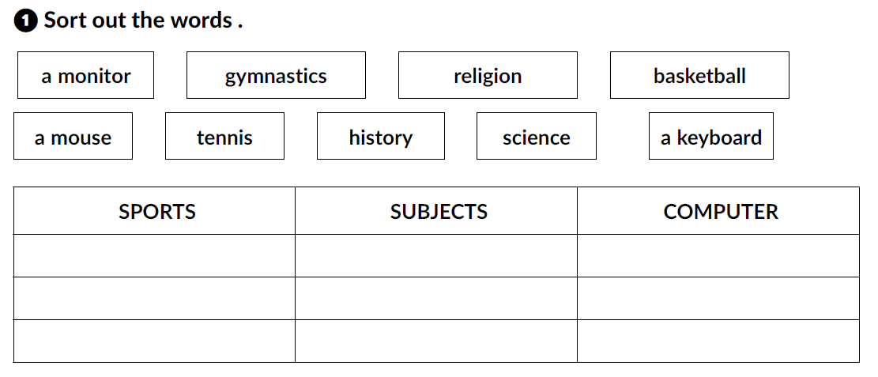
workbook p. 16/17
gymnastics
religion
a monitor
basketball
history
a mouse
tennis
science
a keyboard

Slide 3
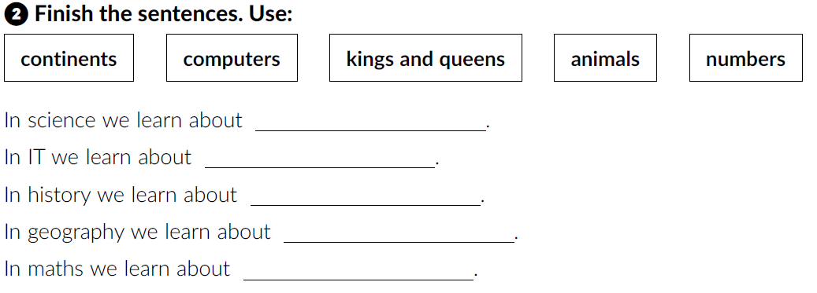
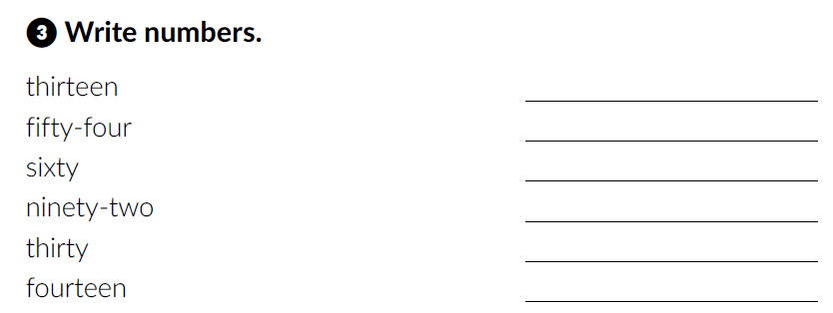
animals
computers
kings and queens
continents
numbers
13
54
60
92
30
14

Slide 4
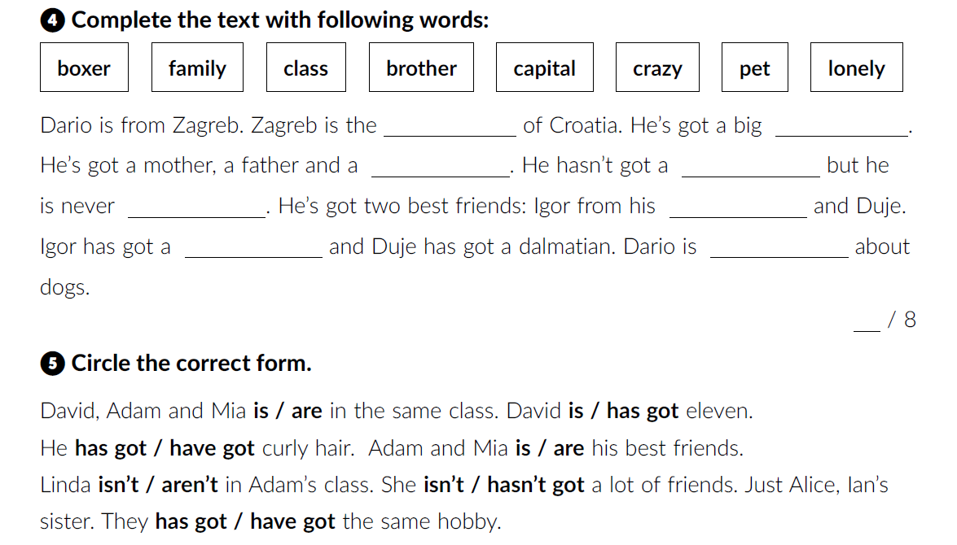
capital
family
pet
brother
lonely
class
boxer
crazy

Slide 5
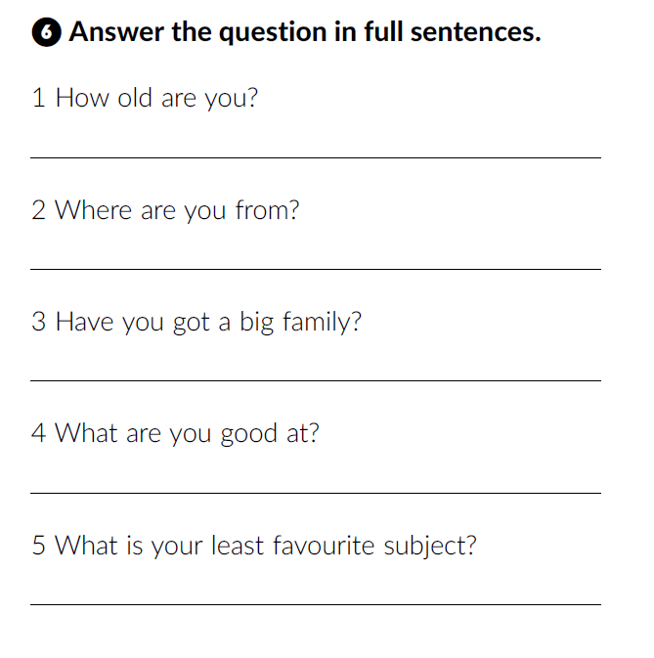
What about you?

Slide 6
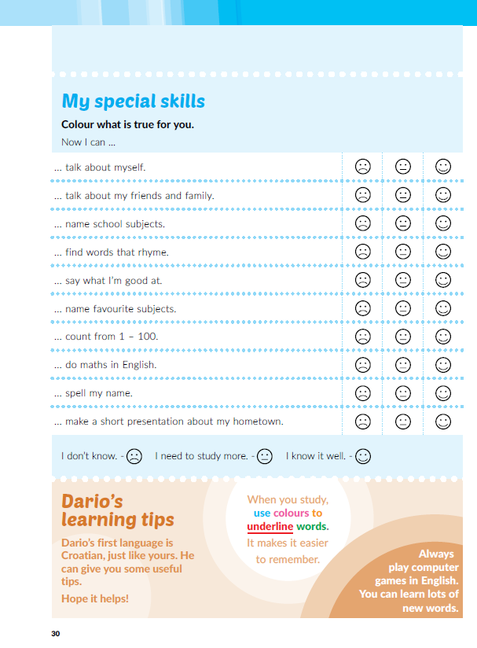
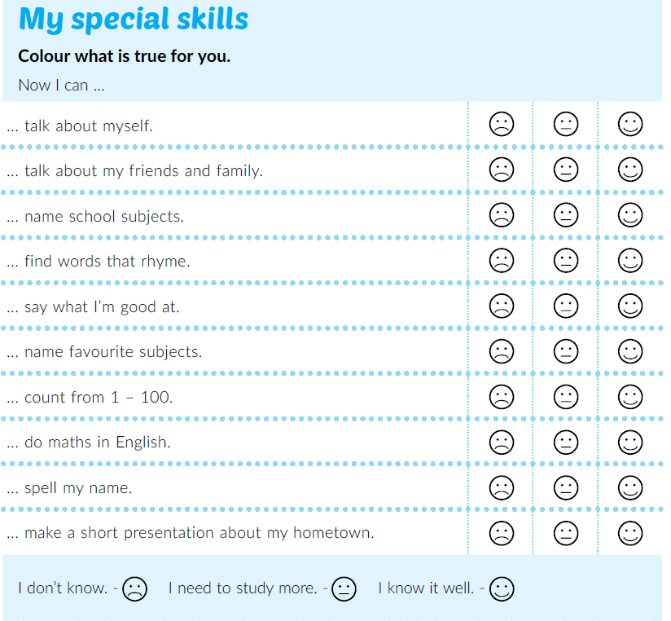
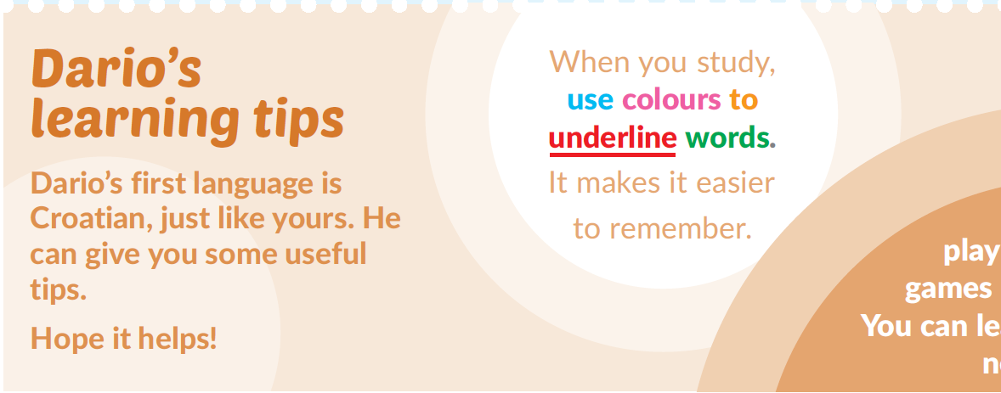
Open your book at page 30.
Read Dario’s learning tips.

Slide 7
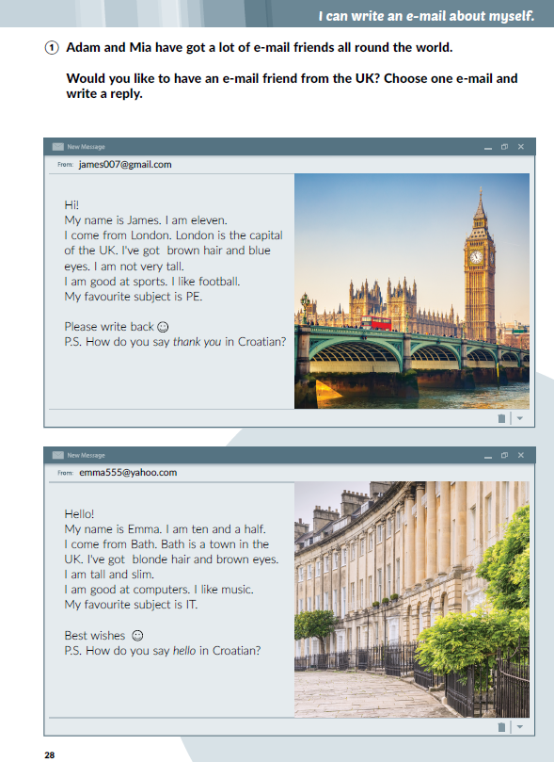
Textbook p. 28
Would you like to have an e-mail friend from the UK?
Read the e-mails.
Where are James and Emma from?
How old are they?
Where do they live?
What are they good at?
What do they want to learn about in Croatian?

Slide 8
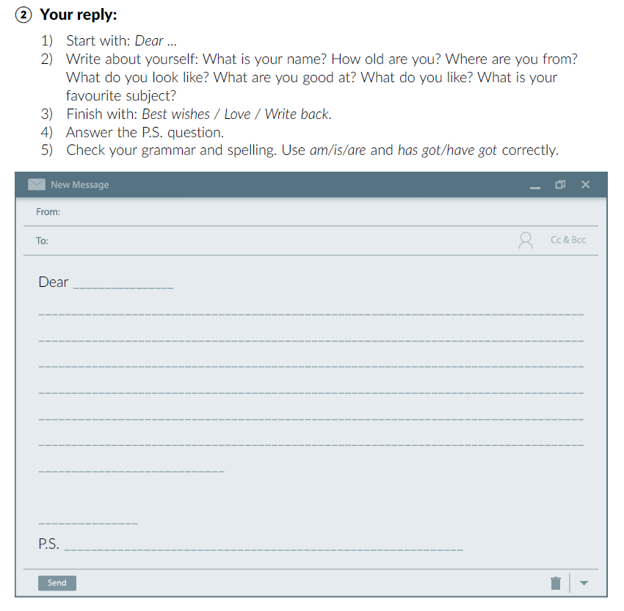
Choose one of the e-mails and write your reply.
Before you start, read the instructions carefully.

